Slide 1
Bioinformatics: Computation and Analysis of Genetics and Genomics
Sequencing involves understanding the makeup of our DNA (A, T, G, C)
Genes?
How are they organized?
To help diagnose diseases and develop treatment strategies, etc.
Pattern recognition (from other genomes such as mice, insects, plants, etc.)
At least 80% protein coding similarities between mice and humans.
What can we learn from patterns different genomes?
Involves massive computation, disparate data (fragmented sub-sequences, etc.)
Pick differences in DNA
How cells compare?
mutations
Biopython: Mature codebase, extensive functionality
SeqIO – Sequence I/O interface for Biopython

Slide 2
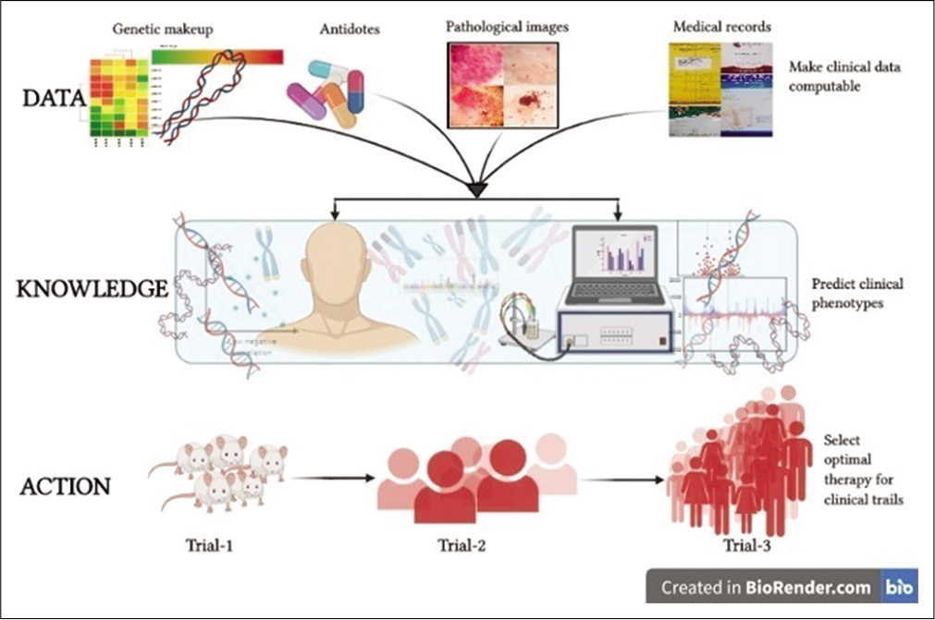
https://dx.doi.org/10.25259/IJMIO_28_2020

Slide 3
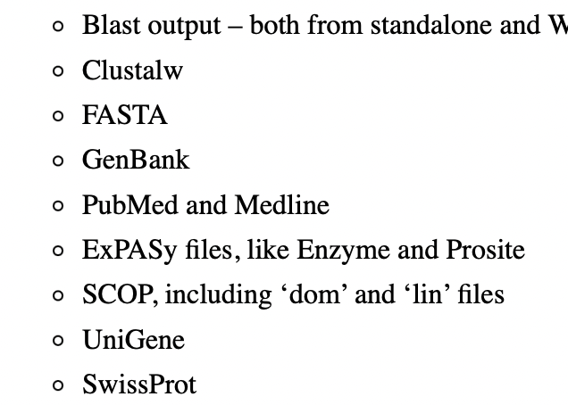
Biopython
Library built on python package
Supports sequencing (nucleotide --> protein) strategies and tools
Supports various file formats.
conda install biopython
import Bio
from Bio import SeqIO

Slide 4
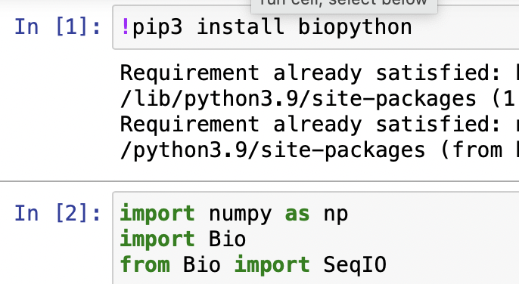
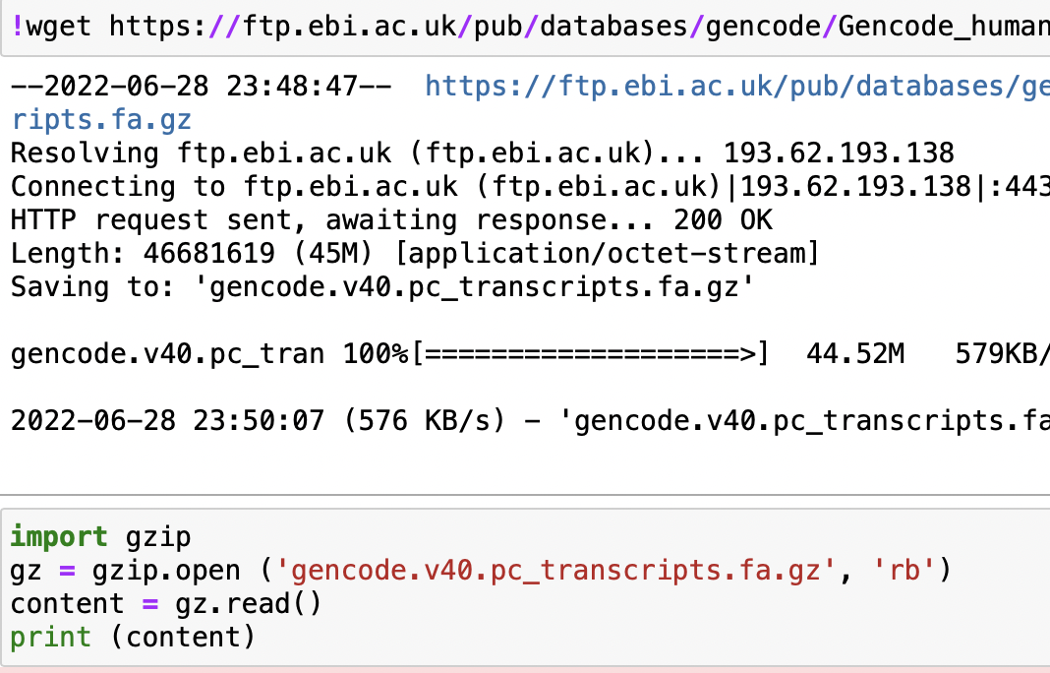
Jupyter Notebook: Sequencing Data File I/O

Slide 5
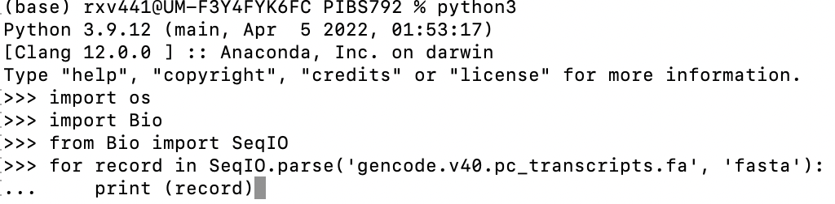
Command Line: Sequencing Data File I/O

Slide 6
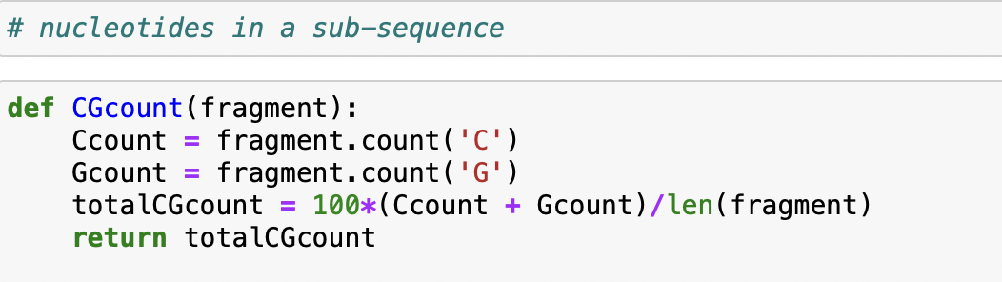
Pattern Recognition
Read sequence and find nucleotides
How many Cs and Gs?
Total GC content?
Check for ‘CGAC’ and print yes!
…
Sub-sequence: ‘CCCAGATCTCTTCAGTTTTTATGCCTCATTCTGTGAAAATTGCTGTAGTCTCTT’

Slide 7
Lab Write Gene Class (for fun!)
Purpose: The Gene class reads a subsequence and finds percentage of Cs and Gs and calculates total CG percentage in the subsequence.
Argument: fragment
Methods: Set/Get
Approach: Read “fragment” into string, find # of Cs and # of Gs using .count() method for strings.
Note: NCBI sequence files often have mixed letters – upper and lower case. Make sure the program handles it!

Slide 8
Finding a base pair in a sub-sequence
Use “re module” (re: regular expression)
Two methods: re.search(), re.finditer(), and more …
import re
subseq = “AGCGCTTTTTACGACCA”
match = re.search(‘GC’, subseq)
if match:
print(match.start(), match.end()) #returns start, end positions of ‘GC’
Find all occurrences of ‘GC’ in the subsequence
If match:
for i in match.finditer(‘GC’):
print(match.start(), match.end(), subseq(match.start(), match.end))
Pipelines
match2 = re.search(‘GC|TA’)
If match2:
for j in match2.finditer(‘GC|TA’):
print(match2.start(), match2.end(), subseq(match2.start(), match2.end())

Slide 9
Tutorials
Biopython tutorial and cookbook
https://data-flair.training/blogs/python-directory/
https://www.youtube.com/watch?v=OQlwLMCinhs

